Slide 1
Design of Experiments
Steve Van Dien
Nov. 29, 2018

Slide 2
Agenda
Overview – what is DOE?
Factorial designs – basic concepts
Statistical background – ANOVA and regression
Developing fractional factorial designs
Hands on example in R

Slide 3
Introduction: What is meant by DOE?
Experiment -
A test or a series of tests in which purposeful changes are made to the input variables or factors of a system so that we may observe and identify the reasons for changes in the output response(s).
Question: 5 factors, and 2 response variables
Want to know the effect of each factor on the response and how the factors may interact with each other
Want to predict the responses for given levels of the factors
Want to find the levels of the factors that optimizes the responses - e.g. maximize Y₁ but minimize Y₂
Time and budget allocation for number of test runs

Slide 4
Basic Principles
Statistical design of experiments (DOE)
the process of planning experiments so that appropriate data can be analyzed by statistical methods that results in valid, objective, and meaningful conclusions from the data
involves two aspects: design and statistical analysis

Slide 5
Strategy of Experimentation
Best guess approach (trial and error)
can continue indefinitely
cannot guarantee best solution has been found
One-factor-at-a-time (OFAT) approach
inefficient (requires many test runs)
fails to consider any possible interaction between factors
Factorial approach (invented in the 1920’s)
Factors varied together
Correct, modern, and most efficient approach- do not need to try every possible combination
Can determine how factors interact
Used extensively in industrial R&D, and for process improvement.

Slide 6
Statistical Design of Experiments
All experiments should be designed experiments
Unfortunately, some experiments are poorly designed - valuable resources are used ineffectively and results inconclusive
Statistically designed experiments permit efficiency and economy, and the use of statistical methods in examining the data result in scientific objectivity when drawing conclusions.
All DOE are based on the same statistical principles and method of analysis - ANOVA and regression analysis.

Slide 7
In general, by using DOE, we can:
Learn about the process we are investigating
Screen important variables
Build a mathematical model
Obtain prediction equations
Optimize the response (if required)
Statistical significance is tested using ANOVA, and the prediction model is obtained using regression analysis.

Slide 8
Applications of DOE in Biotechnology
Optimization of small-scale culture conditions
Factors: shaking speed, fill volume, media, temperature
Response: product yield, product titer, byproducts, OD
Fermentation optimization
Factors: pH, temperature, inoculum size, aeration
Response: titer, rate, yield
Pathway engineering
Factors: gene, promoter, RBS
Response: expression, product titer
Enzyme engineering
Factors: presence/absence of specific mutations
Response: specific enzyme activity

Slide 9
Three basic principles of Statistical DOE
Replication
allows an estimate of experimental error
allows for a more precise estimate of the sample mean value
Randomization
cornerstone of all statistical methods
“average out” effects of extraneous factors
reduce bias and systematic errors
Blocking
increases precision of experiment
“factor out” variable not studied

Slide 10
Guidelines for Designing Experiments
Recognition of and statement of the problem
Need to develop all ideas about the objectives of the experiment - get input from everybody - use team approach.
Use non-statistical knowledge of problem
Choice of factors, levels, ranges, and response variables.
Need to use engineering judgment or prior test results.
Choice of experimental design
Sample size, replicates, run order, randomization, software to use, design of data collection forms.

Slide 11
Performing the experiment
Vital to monitor the process carefully, and ensure consistency in experimental procedure and measurement techniques
Statistical analysis of data
Provides objective conclusions - use simple graphics whenever possible.
Keep analysis as simple as possible
Conclusion and recommendations
Follow-up test runs and confirmation testing to validate the conclusions from the experiment.
Experiments are usually iterative
Do we need to add or drop factors, change ranges, levels, new responses, etc.. ???
Don’t expend all resources in first iteration

Slide 12
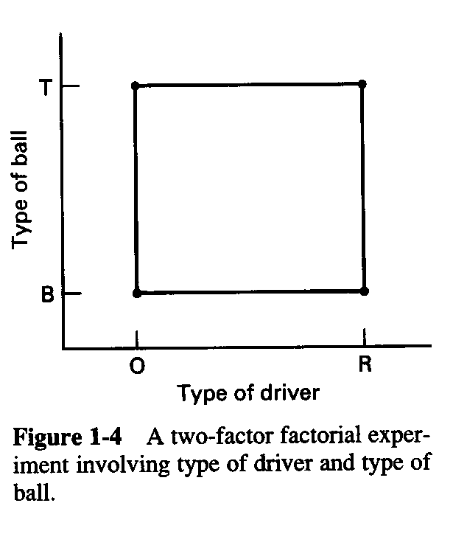
Factorial Designs
In a factorial experiment, all possible combinations of factor levels are tested
The golf experiment:
Type of driver (over or regular)
Type of ball (balata or 3-piece)
Walking vs. riding a cart
Type of beverage (Beer vs water)
Time of round (am or pm)
Weather
Etc, etc, etc…

Slide 13
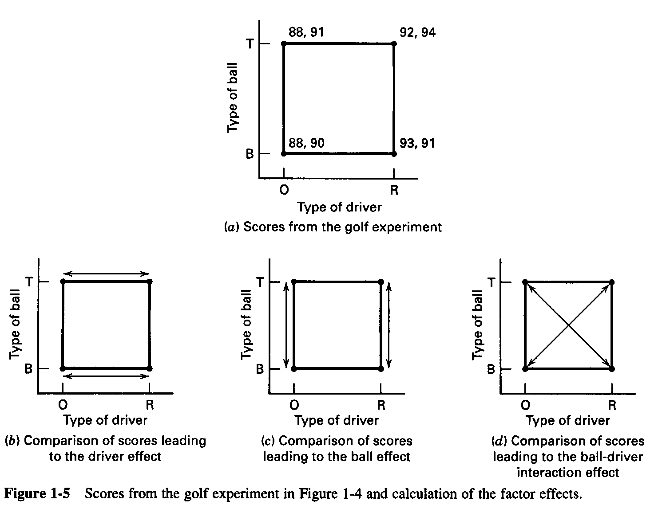
Factorial Design

Slide 14
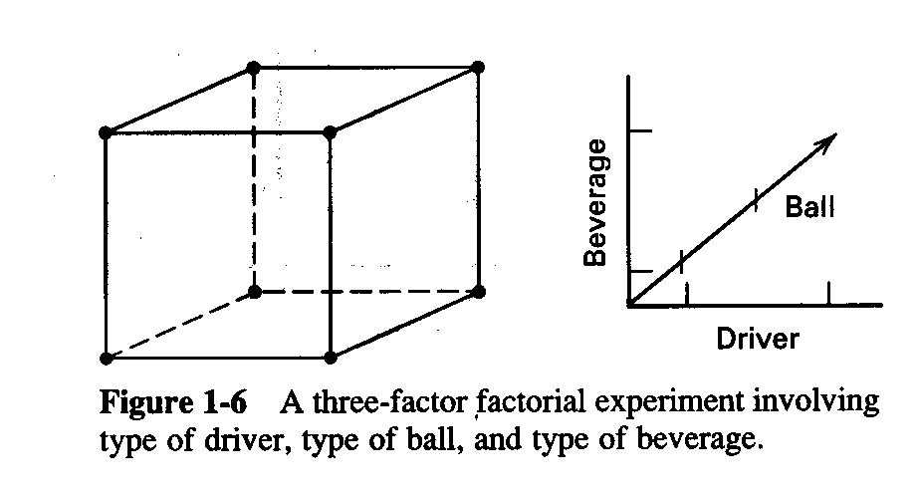
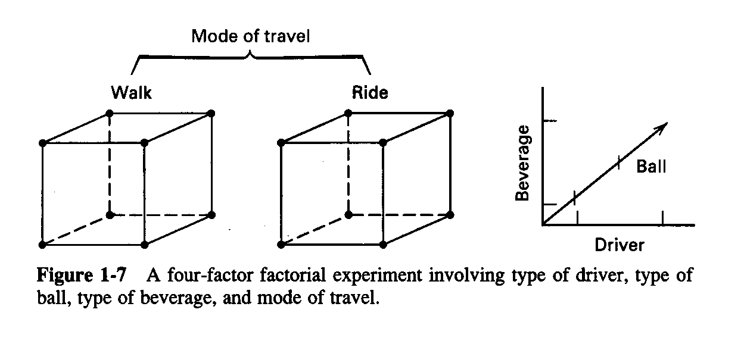
Factorial Designs with Several Factors

Slide 15
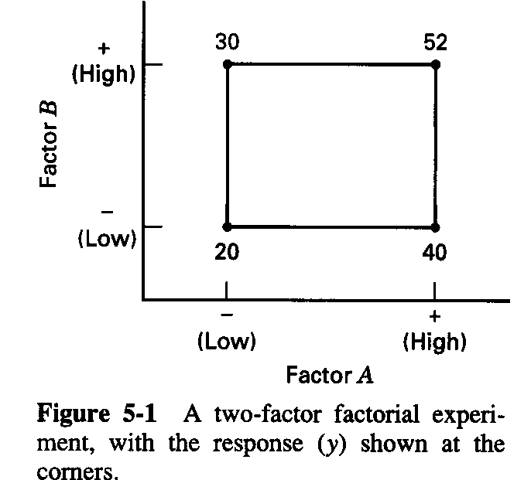
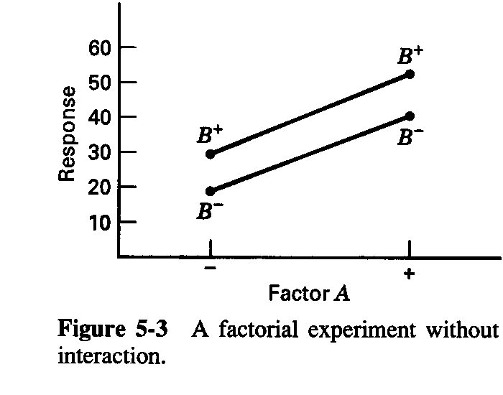
Factor Effects
Definition of a factor effect: The change in the mean response when the factor is changed from low to high

Slide 16
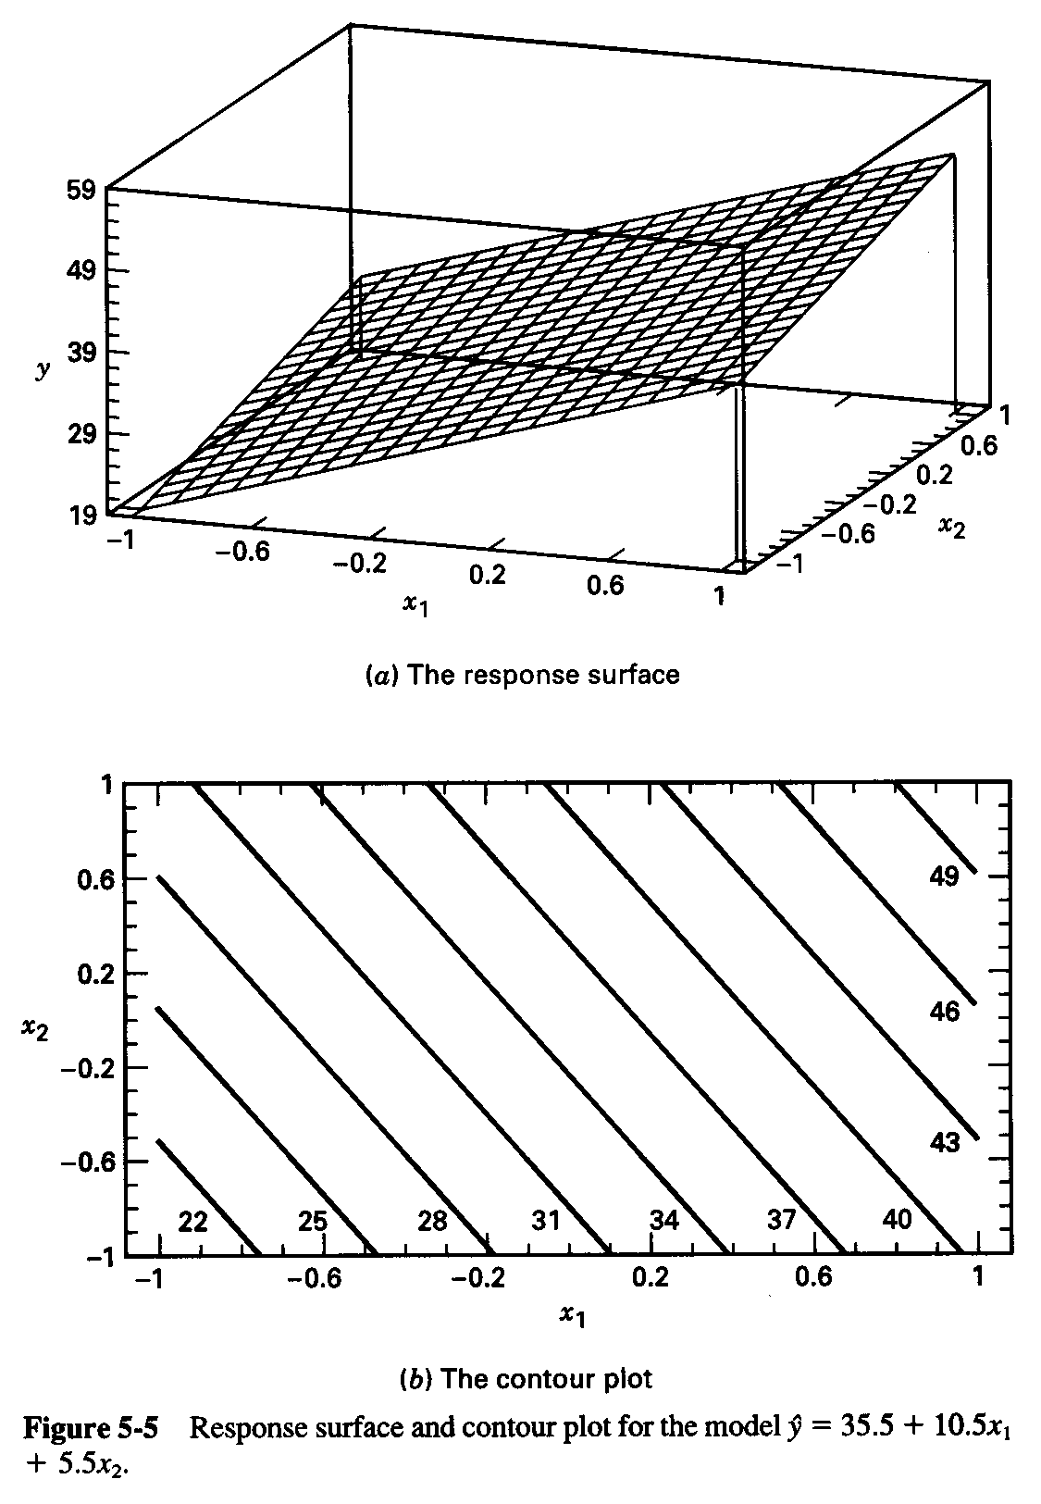
Regression Model & The Associated Response Surface

Slide 17
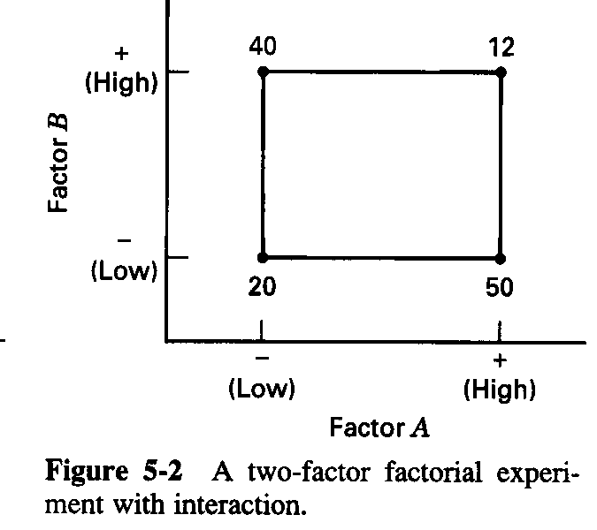
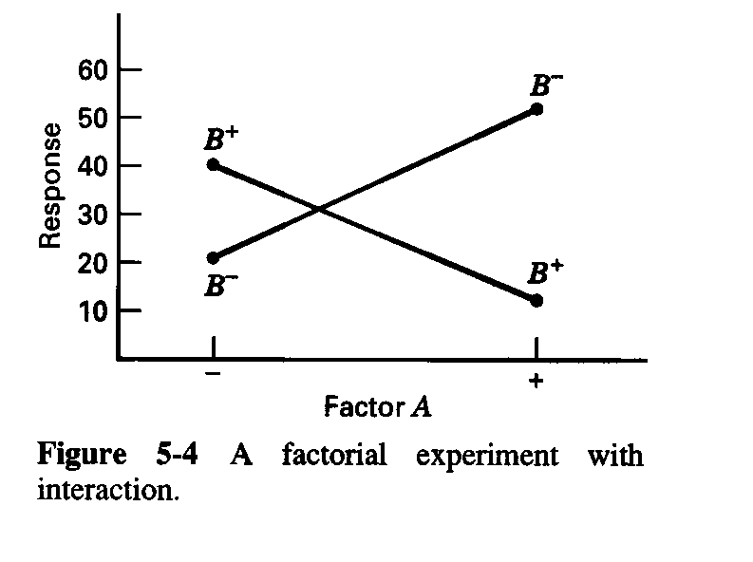
The Case of Interaction:

Slide 18
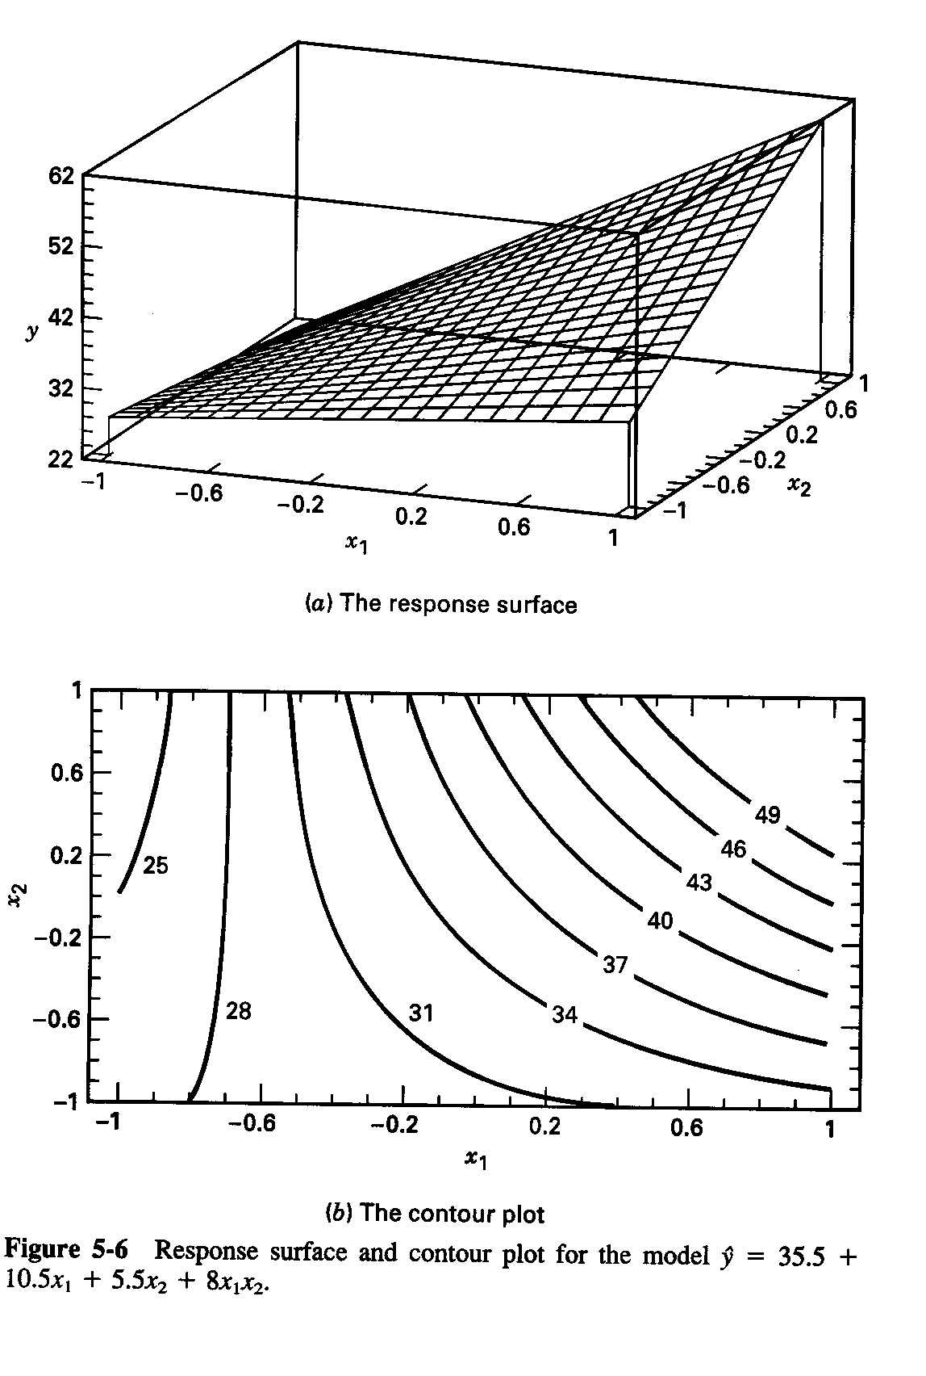
The Effect of Interaction on the Response Surface
Suppose that we add an interaction term to the model:
Interaction is actually a form of curvature

Slide 19
Simple Conceptual Examples
No Interaction
Essentially, output is a linear function of the two inputs
Liquid volume = starting volume + volume added
Interaction
Can be positive or negative (coefficient of AB term)
Positive indicates synergistic behavior
Second order chemical reactions
Cooperative binding of transcription factors
Negative indicates antagonism
Adverse drug interactions
Interactions are not the same thing as dependent variables!

Slide 20
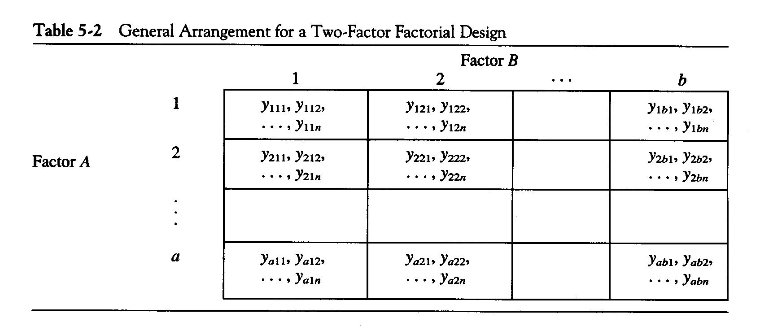
General Two-Factor Factorial Experiment
a levels of factor A; b levels of factor B; n replicates
This is a completely randomized design

Slide 21
The Analysis of Variance (Digression)
The name “analysis of variance” stems from a partitioning of the total variability in the response variable into components that are consistent with a model for the experiment
The basic single-factor ANOVA model is

Slide 22
The Analysis of Variance
Total variability is measured by the total sum of squares of the deviation from the mean:
The basic ANOVA partitioning is:

Slide 23
The Analysis of Variance
A large value of SS_{Treatments} reflects large differences in treatment means
A small value of SS_{Treatments} likely indicates no differences in treatment means
Formal statistical hypotheses are:

Slide 24
The Analysis of Variance
While sums of squares cannot be directly compared to test the hypothesis of equal means, mean squares can be compared.
A mean square is a sum of squares divided by its degrees of freedom:
If the treatment means are equal, the treatment and error mean squares will be (theoretically) equal.
If treatment means differ, the treatment mean square will be larger than the error mean square.
a = number of treatments; n = number of replicates per treatment

Slide 25
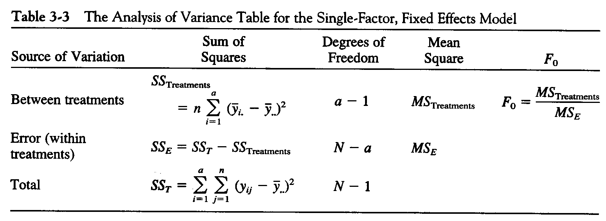
The Analysis of Variance is Summarized in a Table
(N=an)
The reference distribution for F₀ is the F_{a-1, a(n-1)} distribution
Reject the null hypothesis (equal treatment means) if

Slide 26
2-Factor ANOVA Model
Error
First factor
Second factor
Interaction
ANOVA model does not allow for quantitative prediction of responses - treats all factors as qualitative.
Regression model allows for prediction of responses when we have quantitative factors.

Slide 27
Extension of the ANOVA to Factorials (Fixed Effects Case)

Slide 28
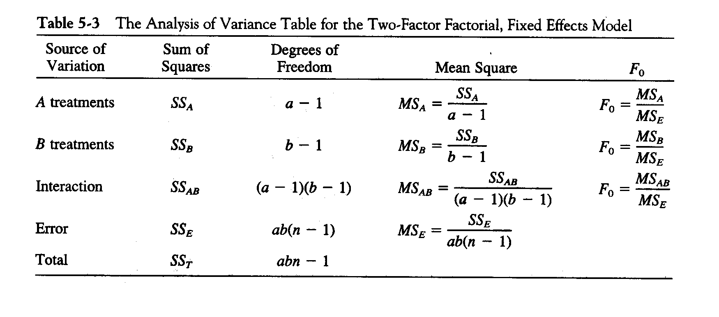
ANOVA Table – Fixed Effects Case
Software available to perform calculations
R
JMP
Design Expert

Slide 29
Factorials with More Than Two Factors
Basic procedure is similar to the two-factor case; all abc…kn treatment combinations are run in random order
ANOVA identity is also similar:

Slide 30
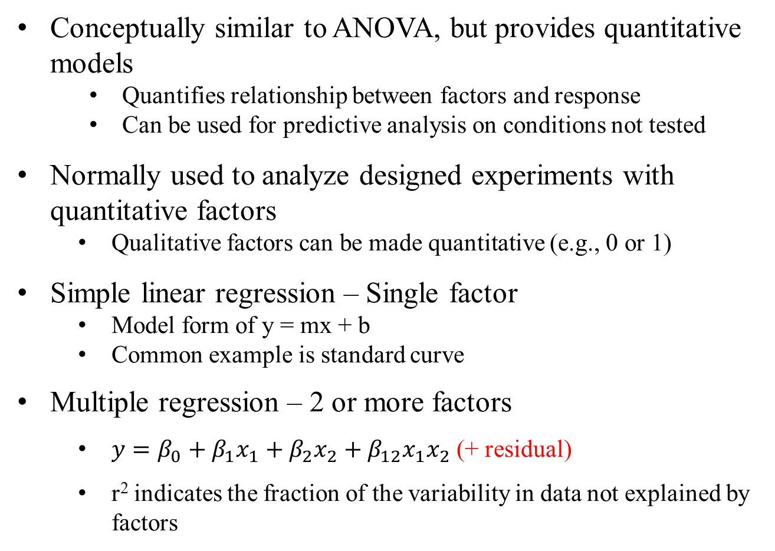
Regression Models
Conceptually similar to ANOVA, but provides quantitative models
Quantifies relationship between factors and response
Can be used for predictive analysis on conditions not tested
Normally used to analyze designed experiments with quantitative factors
Qualitative factors can be made quantitative (e.g., 0 or 1)
Simple linear regression – Single factor
Model form of y = mx + b
Common example is standard curve
Multiple regression – 2 or more factors
$y=β_{0}+β_{1}x_{1}+β_{2}x_{2}+β_{12}x_{1}x_{2}$ (+ residual)
r² indicates the fraction of the variability in data not explained by factors

Slide 31
More than 2 factors
With more than 2 factors, the most useful type of experiment is the 2-level factorial experiment.
Most efficient design (least runs)
Can add additional levels only if required
Can be done sequentially
2- level multifactorial experiments are the topic of the next discussion

Slide 32
Full Factorial Designs
Every combination of each factor is tested
Total number of runs for experiment with k factors is 2^{k}
Gives most complete information, and will find theoretically guarantee optimum
Only practical for small number of factors and/or inexpensive experiments

Slide 33
Fractional Factorial Designs
Experimental designs requiring only a fraction of the total number of runs of a full factorial
Always accompanied by some degree of confounding (lower order effects confounded with each other or with higher order ones)
Denoted by 2^{k-p}
k is the number of variables
2^{k-p} is the total number of runs
p is the number of extra variables beyond a full factorial

Slide 34
Fractional Factorial Designs
Total number of runs must be a power of 2
Design is always some fraction 1/2^{p} of a 2^{k} full factorial design
Which fraction of the total possibilities do you choose?
Design rules for how to generate tables of runs
Better yet, let the computer generate it for you!
Adding replicates will double (or triple) the number of runs needed
Use blocking to reduce error due to uncontrollable factors (e.g., week to week variability)

Slide 35
Confounding and Resolution of Study
Full factorials have 2^{k}-1 degrees of freedom
Each DoF enables us to measure one effect, so in a full factorial we can determine all effects
For 3-factor experiment, 2^{k}-1=7 so we can determine A, B, C, AB, AC, BC, and ABC
In fractional experiments, we have reduced DoF (2^{k-p}-1) but the same number of effects. Effects are said to be confounded
For 2³⁻¹ experiment, 3 DoF. Can only estimate the following: A-BC, B-AC, and C-AB
Main effects are confounded with 2-way interactions
Only useful if you know interactions are not important

Slide 36
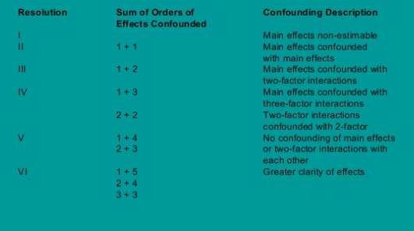
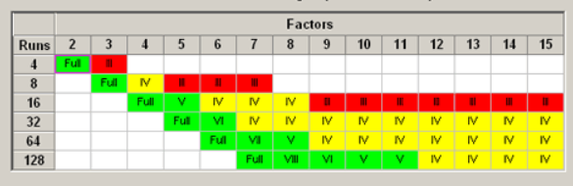
Confounding and Resolution of Study

Slide 37
Alternative Fractional Factorial Designs
Foldover Designs
If you do a fraction of a full factorial in the first iteration, can do the exact inverse in the next
To increase resolution, can just fold over on one or two specific factors of interest
Plackett-Burman Designs
What if we have the capacity to do more runs than 2^{k-p}, but less than 2^{k-p+1}?
These allow you to do any multiple of 4
Partial instead of complete confounding

Slide 38
Higher Order Designs
2-level factorial designs are primarily for screening
To perform optimization of regression, need higher order
3-level designs can estimate quadratic effects
Normally perform higher order experiments with just 1 or 2 factors, or the number of runs becomes unwieldy
Response surface methods
Central composite design
Box-Behnken design

Slide 39
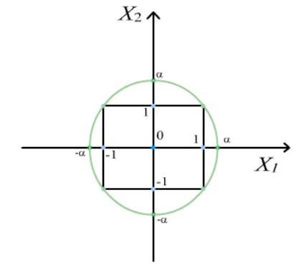
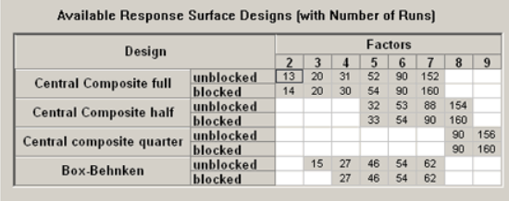
Higher Order Designs

Slide 40
Example – Well plate cultivation
Determine effects of process conditions on production of a particular metabolite
6 factors, 2 levels each
Fill volume (0.7 or 1.2 mL)
Glucose concentration (10 or 20 g/L)
Phosphate buffer (50 or 100 mM)
Trace metals (- or +)
Strain (A or B)
Experimenter (X or Y)
Have the capacity to run 4 24-well plates
Would like triplicates

Slide 41
DOE in R using R Commander interface
Install the following libraries
Rcmdr
RcmdrPlugin.DOE
FrF2
In R command window (not R Studio), type
> library(Rcmdr)
R commander will open
Select Tools → Load Rcmdr Plug-Ins → RcmdrPlugin.DOE
Allow to restart
Select Design → Create design → Regular (Fractional) Factorial

Slide 42
References
D. G. Montgomery (2008): Design and Analysis of Experiments, 7th Edition, John Wiley and Sons
one of the best book in the market. Uses Design-Expert software for illustrations. Uses letters for Factors.
G. E. P. Box, W. G. Hunter, and J. S. Hunter (2005): Statistics for Experimenters: An Introduction to Design, Data Analysis, and Model Building, John Wiley and Sons. 2nd Edition
Classic text with lots of examples. No computer aided solutions. Uses numbers for Factors.
Many others

